Slide 1

Handwritten text to Digital Text Conversion using Deep Learning
By
Shiny Sherly Katuru - 700744314
Sneha Latha Kusuma - 700745374
Bhavyasri Maddineni - 700748499

Slide 2
Motivation
This conversion provides solutions to the various problems such as physical damage of the document, accessing the document from anywhere around the world, transferring the document and security related problems.
Handwritten Text Recognition (HTR) or Handwriting Recognition (HWR) plays an important role to recognize the handwritten text from the input scanned images and converts it into digital format.

Slide 3
Problem Statement
OCR recognizes character and they are differentiated based on the shape.
It is used as an input device for pre - printed documents to read alpha-numeric characters.
OCR system does not contain many tools to handle handwriting recognition. As the handwritings differ from person to person, traditional OCR system cannot recognize everyone's handwriting.
To recognize all the different handwritings successfully complex deep learning algorithms are to be used.

Slide 4
Objectives
Character Extraction: It involves scanning of image and then individual character contained is to be extracted.
Character Recognition: Once the individual characters are extracted, the computer outputs the corresponding digital character.
Feature Extraction: In this step the programmer must determine the properties that may appear to be important.

Slide 5
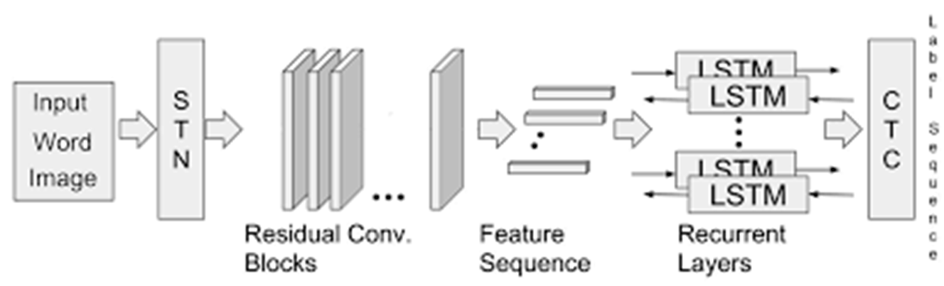
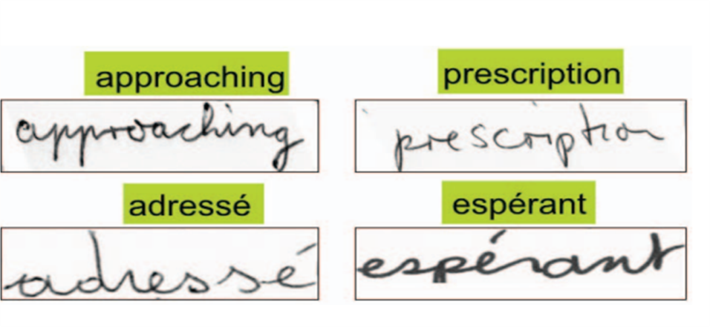
Paper-1
The task of the recognizer is to predict the character string (w) which is later given to a linguistic engine which constrains w to form a valid word.
Improvement in performance can be credited due to:
CNN and RNN.
Better learning schemes and regularizes.
availability of large scale of annotated data

Slide 6
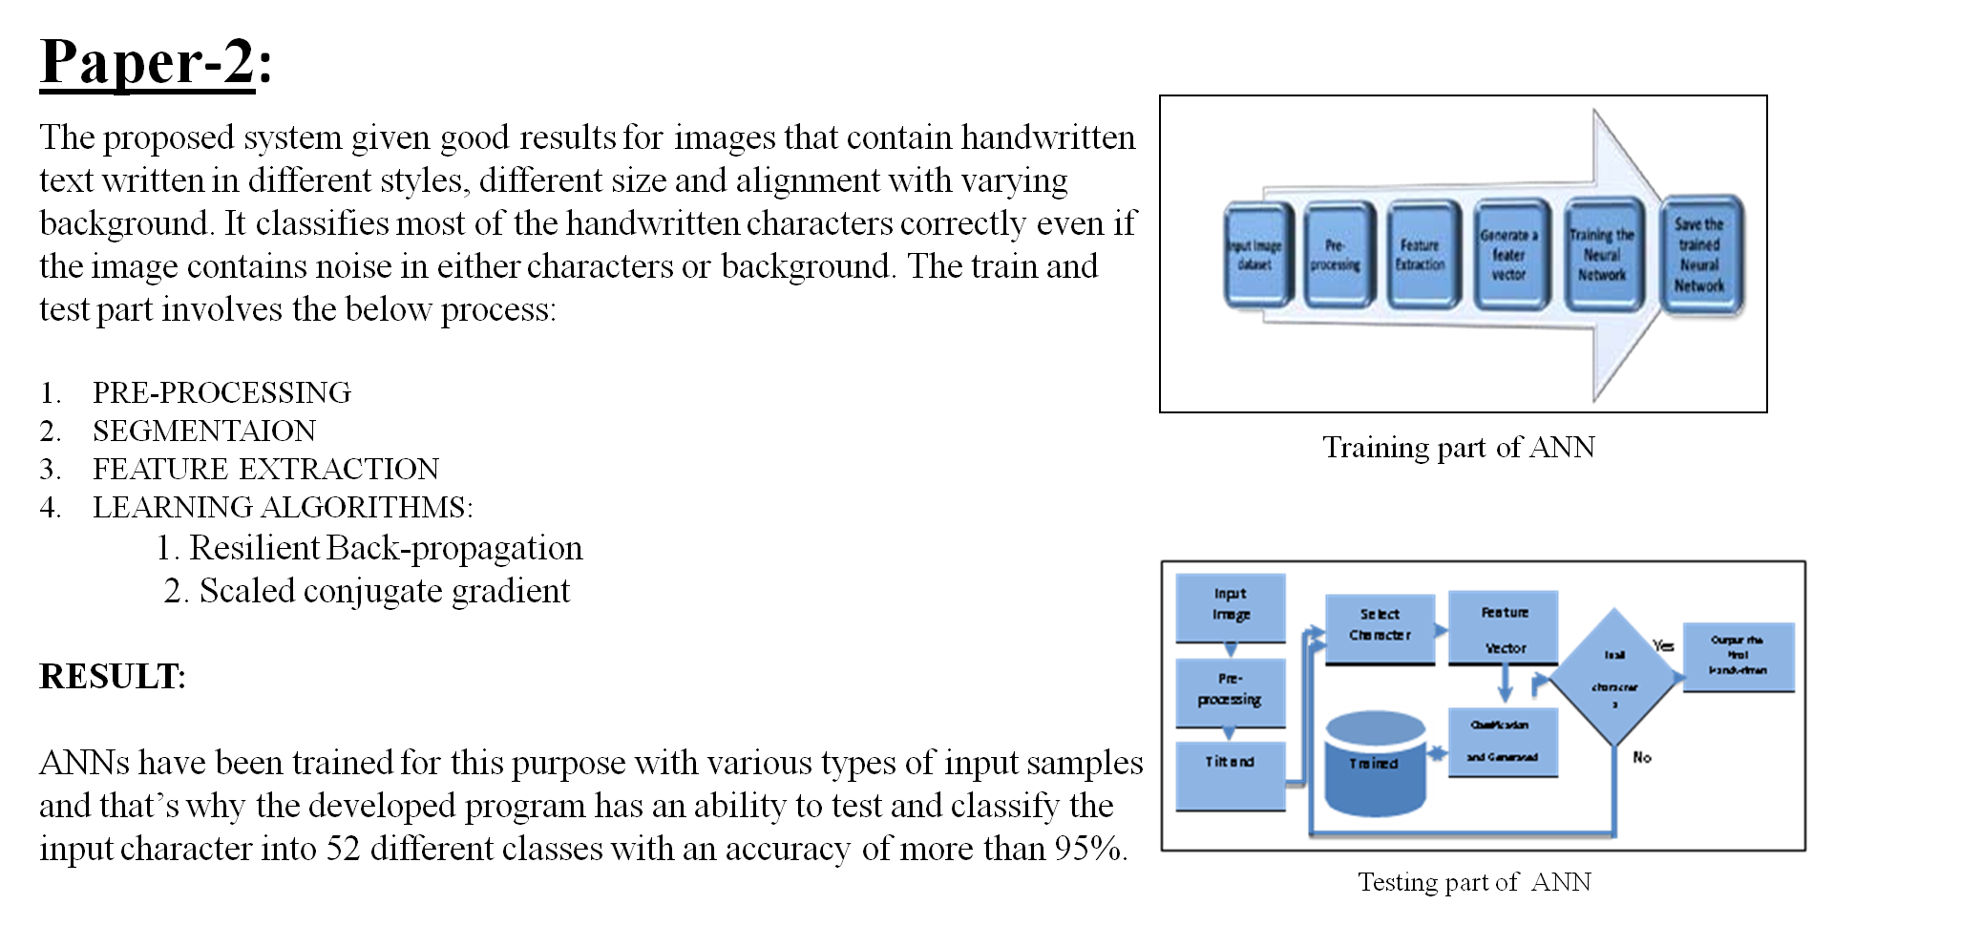

Slide 7
Paper -3
Offline handwritten character Recognition using deep neural networks.
In this system they have used OpenCV for performing image processing and have used Tensor flow for training a neural network.
The backend part performs two important things.
1. Hosting the pre-trained neural network model to serve predictions.
2. Image Processing:
Pre-Processing
Conversion to Gray-Scale
Thresholding
Image Segmentation
Result: This system can recognize the cursive handwritten text.

Slide 8
Expected Results
After training the dataset by using different Neural Network techniques, The best model is selected based on the accuracies that are acquired.
The input sample image is expected to be converted into a digital text.

Slide 9
References
https://www.researchgate.net/publication/298808334_Handwritten_Text_Recognition_System_based_on_Neural_Network
http://www.ijcsit.com/docs/Volume%207/vol7issue1/ijcsit2016070101.pdf
http://cdn.iiit.ac.in/cdn/cvit.iiit.ac.in/images/ConferencePapers/2018/improving-cnn-rnn.pdf
http://cs231n.stanford.edu/reports/2017/pdfs/810.pdf
Handwritten Chinese Text Recognition Using Separable Multi-Dimensional Recurrent Neural Network | IEEE Conference Publication | IEEE Xplore

Slide 10

Video Link:
https://drive.google.com/file/d/15lyo2woUFHbH_DI9EG5gmJnBSHFzrn46/view?usp=share_link

